Slide 1


COMP3411 13A WK2
KELVIN YANG

Slide 2
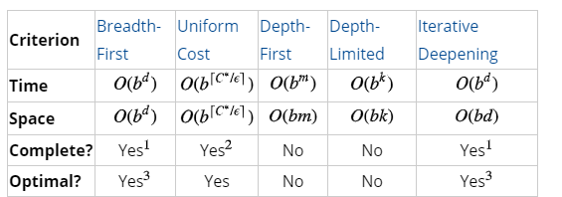
Part 1: Uniformed Search Algorithms
Summary:
Notes:
C*: optimal solution cost, epsilon: minimum action cost

Slide 3
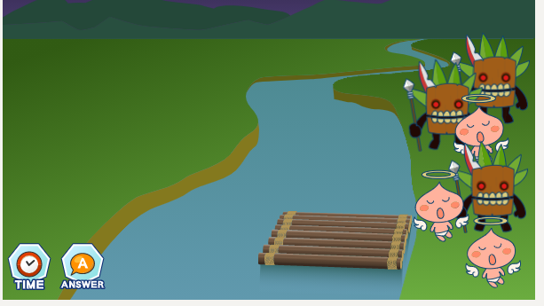
Activity 1: The Missionaries & Cannibals Problem

Slide 4
The Missionaries & Cannibals Problem: Problem and State Formulation
iPad Demonstration

Slide 5
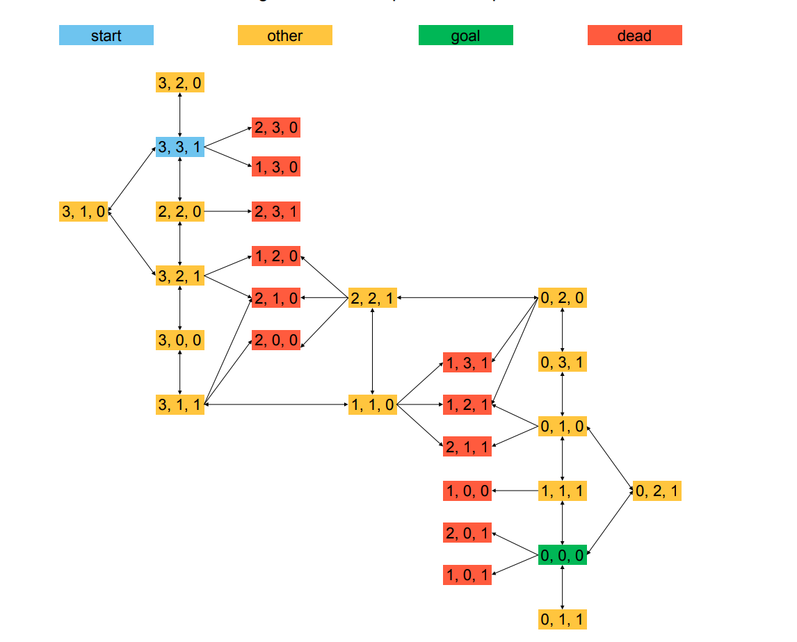
The Missionaries & Cannibals Problem: State Space

Slide 6

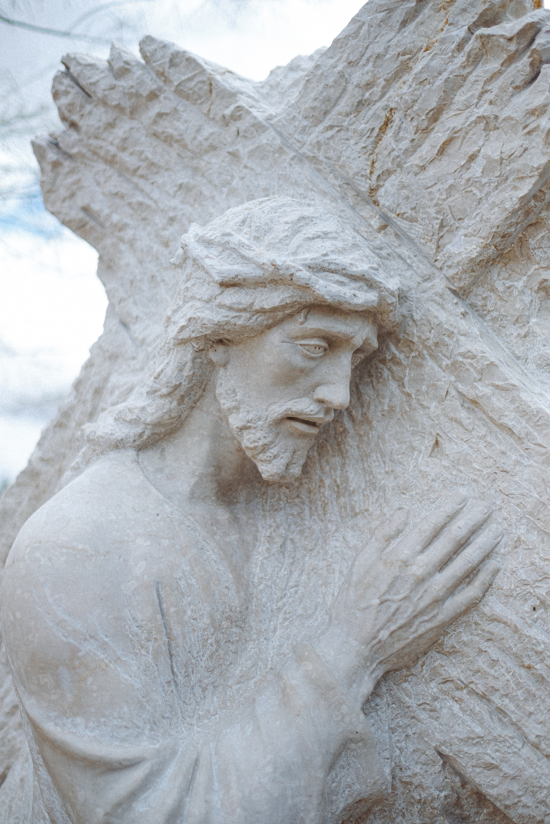
The Missionaries & Cannibals Problem: Optimal Search
BFS & DFS: demo on iPad

Slide 7
The Missionaries & Cannibals Problem: Reflection
Why is it so difficult?
Humans think in terms of heuristics, and bringing 2 people from the other side back to the original side seems counterintuitive.

Slide 8
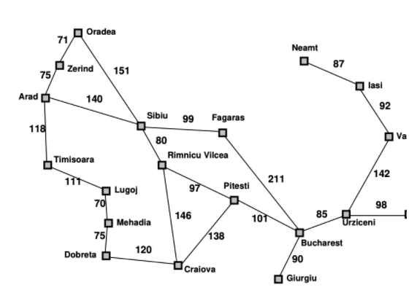
Activity 3: Path Search Algorithms on a Graph

Slide 9

Path Search Algorithms on a Graph
iPad Demo

Slide 10
Part2: Informed Search Algorithms
Key idea: use an available but may not very accurate information (heuristic) to reach the goal as efficiently as possible
Greedy: expands the node purely based on a goal heuristic of neighboring nodes → sweetest fruit first
A*: expands the node based on distance from root to neighbour + heuristic of cost from neighbour to goal -> combines optimality with efficiency
Heuristic Assumption: h(n) < h*(n) for all n, where n is any node, h is heuristic used, h* is true cost from n to goal

Slide 11
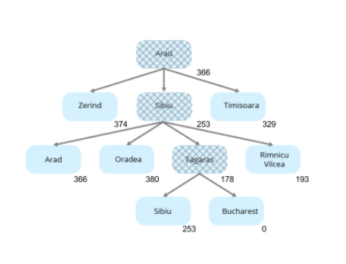
Activity 1: Path Search Algorithms on a Graph: Greedy

Slide 12
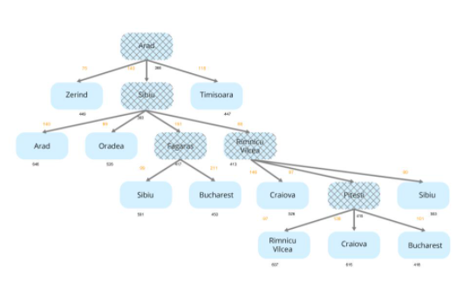
Activity 1: Path Search Algorithms on a Graph: A*

Slide 13

Activity 2: Relationships Between Search Strategies
Key is in evaluating which neighboring nodes to expand next
iPad Demo

Slide 14
Activity 3: Heuristic Path Algorithm
iPad Demo

Slide 15
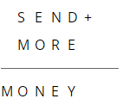
Part 3: Constraint Satisfaction
Activity 1: Cryptarithmetic
Eliminate unfit digit one by one
iPad demo

Slide 16
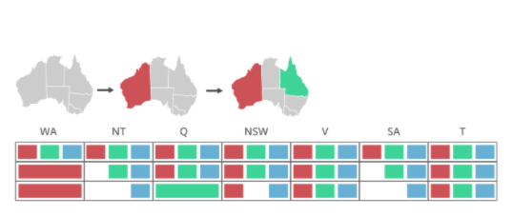
Activity 2: Forward Checking and Arc Consistency
iPad Demo

Slide 17
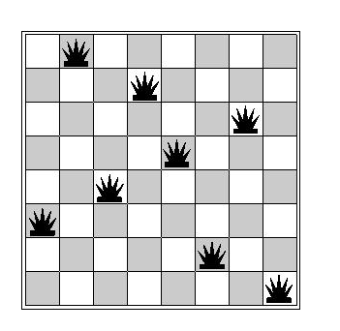
Activity 3: Local Search

Slide 18

Questions/Feedback/Reminder
Any questions?
Any feedback?
Don’t forget to do your homework!
Details in the announcement
Add 1 question each for part 1 and part 2, and part 3 (3 questions in total) to your Microsoft form used for last week’s homework. Share the link with me if you’ve not already done so.
Post these questions to open learning

